Slide 1
The challenges of legal recognition of Agropastoralists land rights in Madagascar
Oginot Germier Manasoa, 2024 May 14th
2024 World Bank Land Conference, Washington DC

Slide 2
The challenges of legal recognition of Agropastoralists land rights in Madagascar
Oginot Germier Manasoa, 2024 May 14th
2024 World Bank Land Conference, Washington

Slide 3
Key messages
1 – Pasturelands in Madagascar :
A territory with known boundaries, but spaces with a mosaic of resources and sub-spaces
A territory that already has several local land rights-holders and can be secured and regulated in different ways
A Territory whose boundaries may evolve in the middle term

Slide 4
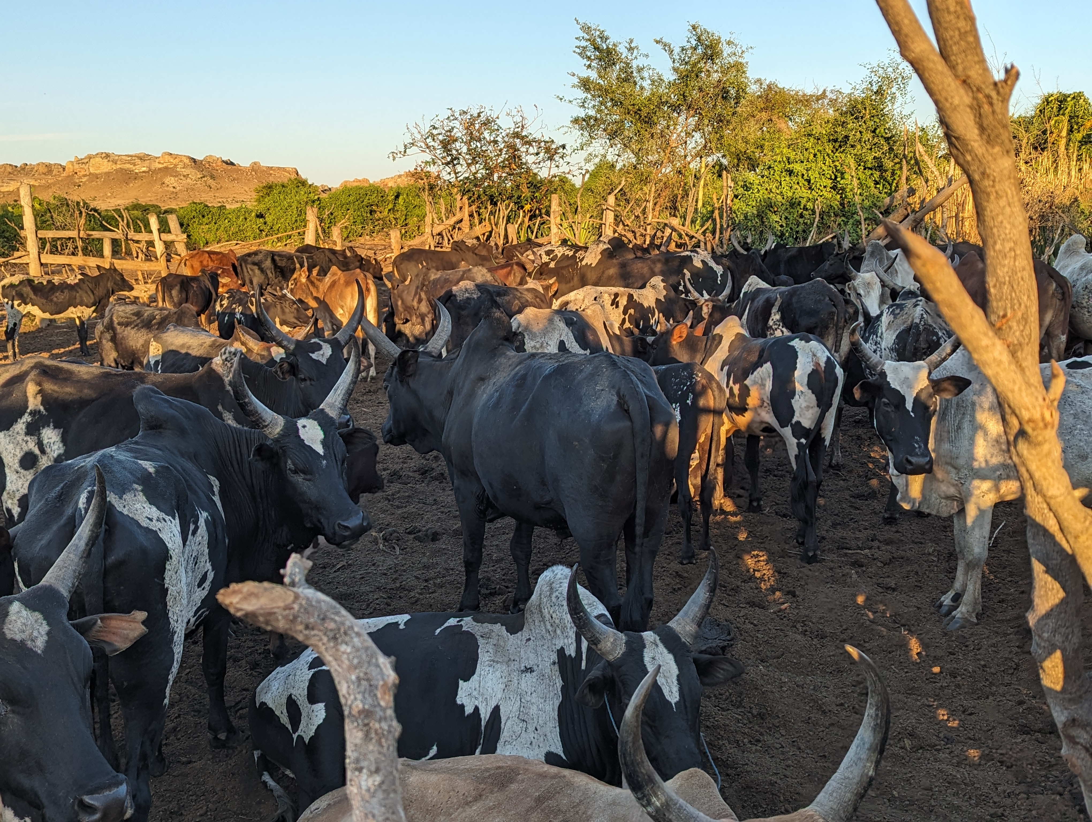
Context Madagascar : socio-economic importance of extensive cattle farming
One household in two has cattle - all agropastoralists
Cattle with important socio-economic functions
(Sources : RGA 2004/2005, RGPH, 2022)
Herding Methods :
A semi-extensive method Grazing close to villages
An extensive method Concerns herds of 50 to 200 head, grazing in large pasturelands
Large pastureland use :
All or part of the year
Herds stay only during the day or days and nights, with or without herdsmen
Herds from surrounding villages + remote villages - Maximum 30 km
= No major transhumance
@Manasoa

Slide 5
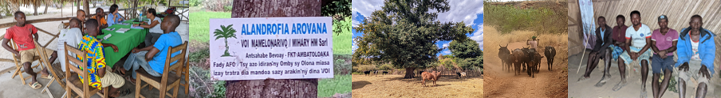
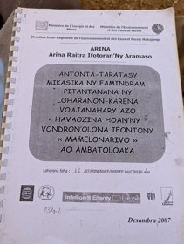
Pasturelands in Madagascar
Little-known areas, subject to preconceived ideas like: “unappropriated areas”
But
=> Areas subject to increasing pressure and competition over use, trends - the private appropriation of land to convert its use
Areas undergoing change and competition over use, affected by
Development of family farming (migrants, young people)
Large-scale corporate farming projects,
Reforestation and conservation projects
@Manasoa

Slide 6
Extensive cattle farming and pasturelands poorly taken into account by public policies and projects
I - Land reform since 2005 offering recognition of customary rights
Possibility of formalizing ownership by a land certificate
legal document
Deliberated by the Communes
With a legal value similar to that of a land title.
But does not concern pastureland:
*Pastureland is considered to be under the ownership and management of the State
*Does not protect herders' rights under the natural resource management Laws
II - 1996 law allows management of land and resources to be entrusted to an association (VOI).
=> Does not protect extensive livestock farming from probable changes in use
So actually, a Draft law covering pasturelands is on the political agenda => Community land rights

Slide 7
Research question
What are the strategies and means used by agropastoralists to protect their access to pastoral resources and maintain their management power over these territories?
@Manasoa

Slide 8
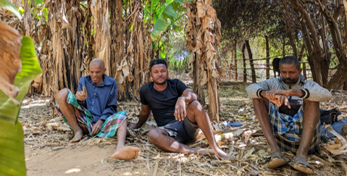
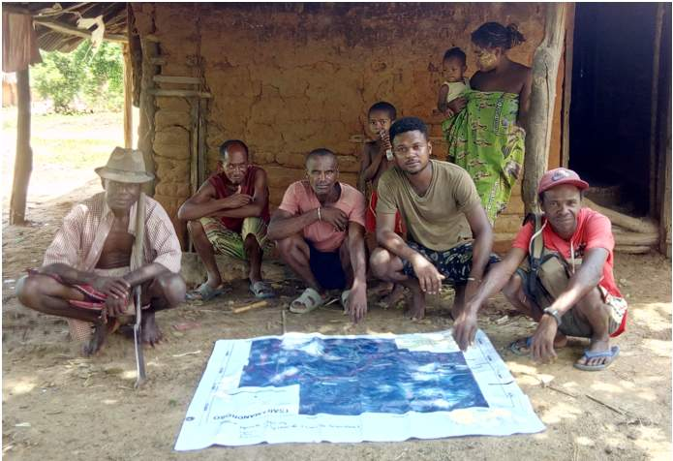
Methodology
Analysis of the bundle of rights to land (Schlager & Ostrom, 1992) and associated resources
Rights under local rules
Analysis of sources of insecurity / challengers
@Manasoa

Slide 9
Methodology
Qualitative Approach:
4 Pasturelands invested in Northwest of Madagascar
Over 250 interviews
Participatory mapping
Several villages and resource persons interviewed

Slide 10
Physical environment of pasturelands

Slide 11
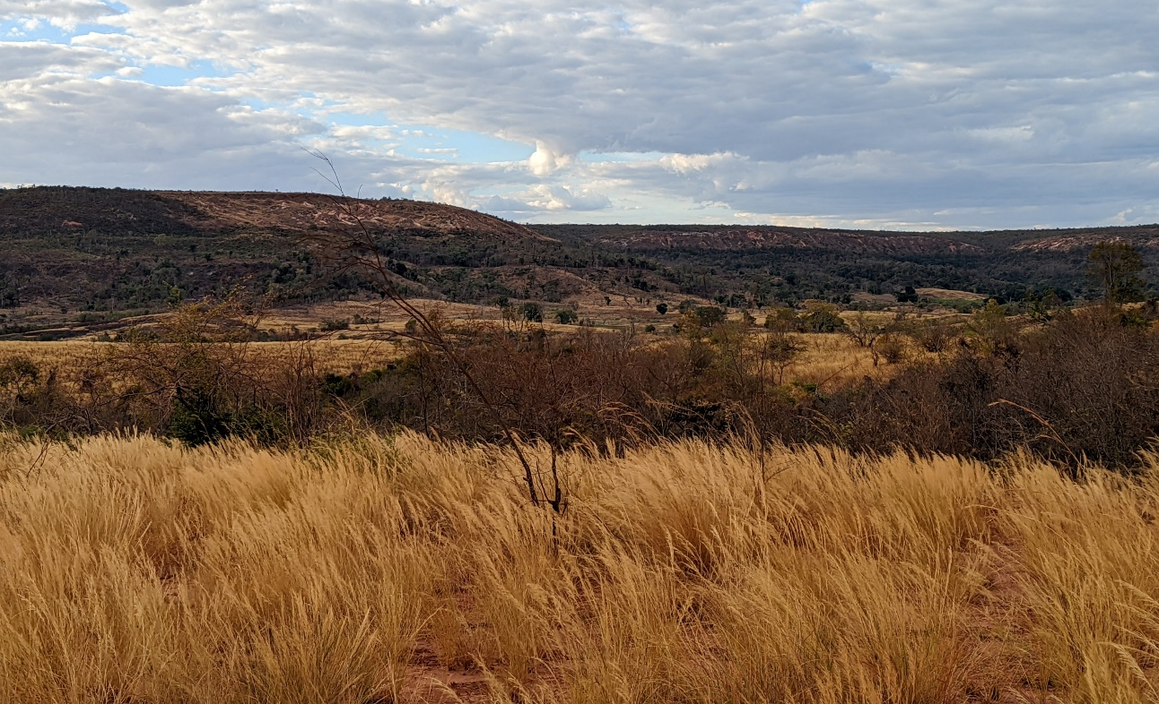
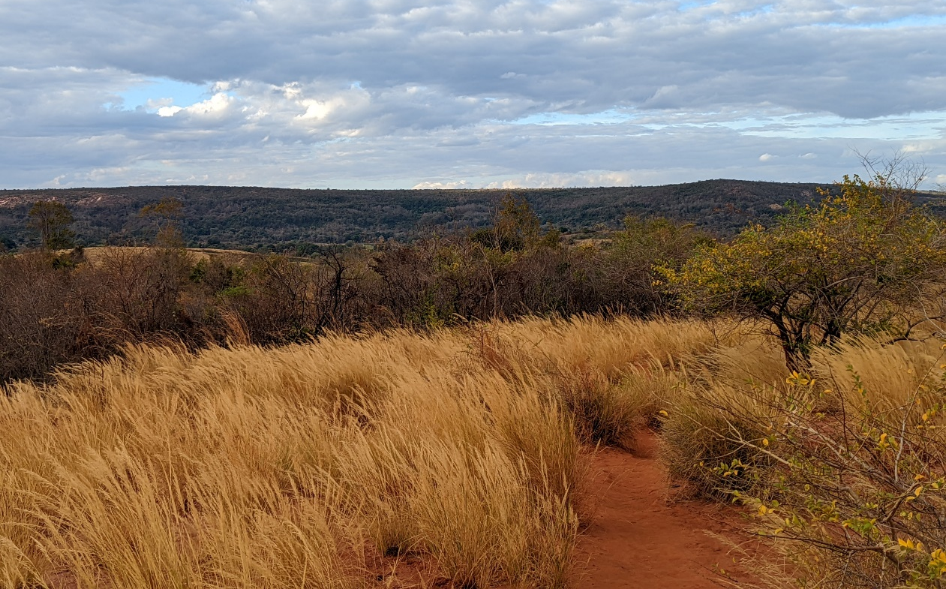
1 – Different from other pastoral areas in Africa
Areas with socially known boundaries (rivers, hills)
Areas of 500 to 5,000 ha
@Manasoa

Slide 12
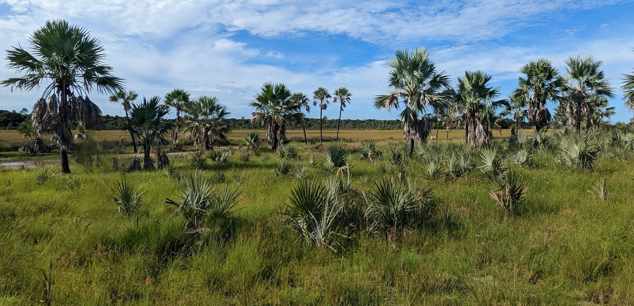
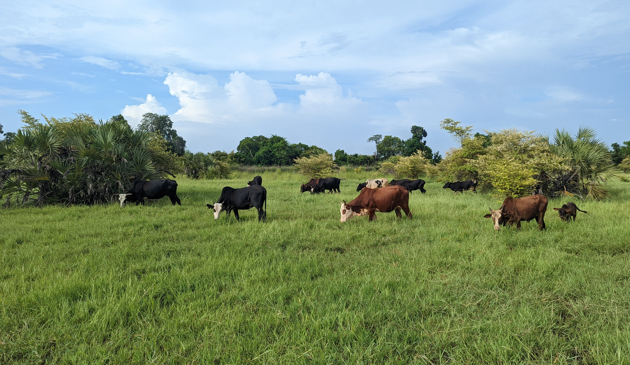
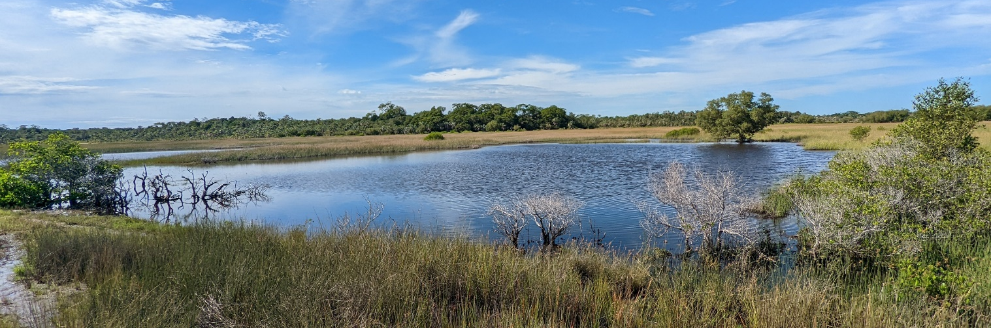
2 – But in some other respects, similar to that of other African countries:
=> rich in several resources (fodder, water, wood, wild animals, etc.)
@Manasoa

Slide 13
Actors in charge of management and users

Slide 14
Within pasturelands: 2 sub-areas to be distinguished
: villages
: villages
Herd gathering place
Fananganan’omby (F.O)
A few hectares
Presence of trees
Near water (pond, river)
: ponds
: ponds
herbaceous or shrubby savannahs
herbaceous or shrubby savannahs
: forest
: forest
Agricultural areas
Herd grazing areas
Kijana
Large areas of savannah
More or less wooded
Several tens of hectares or hundreds of hectares
Agricultural areas
: F.O

Slide 15
Pasturelands : managers and users
Herd gathering place
Fananganan’omby (F.O)
Owner = Big Agropastoralist
rights of use, exclusion, alienation
transfer by inheritance but no sale = Family of Big Agropastoralist
: villages
: villages
: ponds
: ponds
herbaceous or shrubby savannahs
herbaceous or shrubby savannahs
: forest
: forest
Herd grazing areas
Kijana
Managers = families of Big Agropastoralists
Accept entry of outside herders and may exclude them in the event of non-compliance
Accept agricultural cultivation
User rights Users: villagers + Big Agropastoralists from other localities
Agricultural areas
Agricultural areas
: F.O

Slide 16
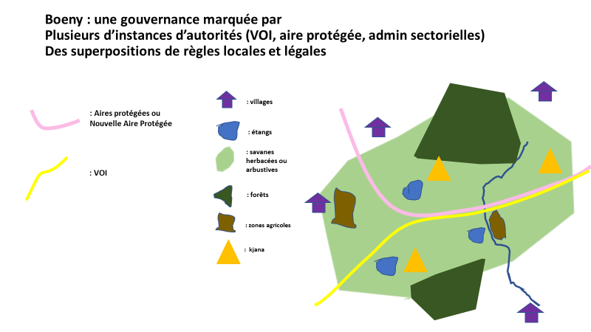
Common non conventional
Clear boundaries OK
Pastoral resources: Collective with rules but a non-formalized collective, no meetings
Other resources: complex mosaic tenure
Common polycentric
Isolated pasturelands - agropastoralists' governance
Pastures included in protected areas or in territories managed by renewable resource management associations (VOI)

Slide 17
Challengers: defense strategies

Slide 18
Agropastoralists'need for protection
Challengers generally from outside the pasturelands
Agropastoralists needs for protection from the outside
@Manasoa

Slide 19
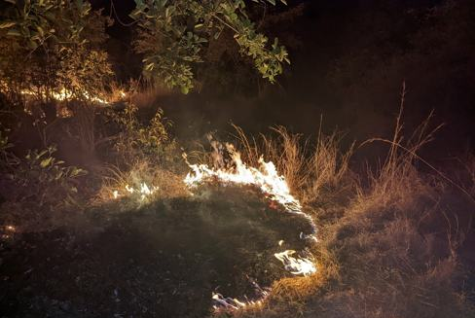
Challengers : organizations from outside the area
Challengers | Reaction and strategies
Protected Area and VOI | Agropastoralists (Individually or collectively)
Challenging management rights, in particular herders' right to fire | Non-compliance with rules
@Manasoa

Slide 20
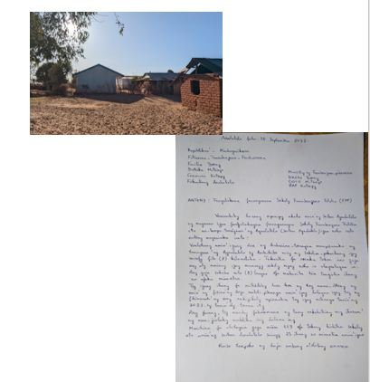
Challengers : entreprise
Challengers | Reactions and strategies
Entreprise | Agropastoralists (individually or collectively)
All rights challenged | More or less pressure from the State - Obligation to negotiate
@Manasoa

Slide 21
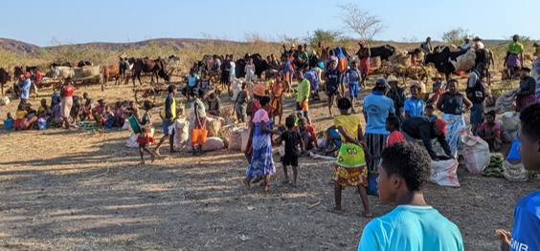
Challengers : local elites
Challengers | Reaction and strategies
local elites who claim control over the land and hand it over to migrants | Agropastoralists (individually or collectively)
Challenging management and usage rights | Alliance with VOI and protected areas
@Manasoa

Slide 22
Challengers : local agropastoralists?
Challengers
Local agropastoralists ?
Infrequent / tensions at the margins of agricultural and livestock zones

Slide 23
How can agropastoralists’ land rights be secured ?

Slide 24
Pasturelands in Madagascar : key messages to remember
1 - A territory with known boundaries, but spaces with a mosaic of resources and sub-spaces
2 - A territory that already has several local land rights-holders and can be secured and regulated in different ways
3- A Territory whose boundaries may evolve in the middle term

Slide 25
Pasturelands already in Protected areas
Negotiation with Protected areas
Pasturelands outside Protected areas
Scope for innovation

Slide 26
Why avoid land titles or certificates for pasturelands ?
Land titles
Too expensive, too cumbersome and inaccessible for local populations
*(very expensive for small area so even more difficult for large – scale pasturelands / even protected areas are not titled in Madagascar)
Certificates or resource management associations
2. difficulty in defining a legal owner
3. difficulty in formalizing a collective

Slide 27
Possible options
I - Collective identification of a territory
A participatory delimitation of a territory with a local and historical basis
Carried out by a local rights recognition committee
Mobilizing local resources, simple techniques and skills at the level of decentralized institutions
II - No owner is defined, only people who cannot own land is defined
A territory that cannot be appropriated by the State
Territory marked in local land-use plans used at commune level
@Manasoa

Slide 28
Possible options
III- Within these territories
Areas appropriated by families and then certified or titled: Agricultural plots - unless opposed by a villager's representative *
IV - Territory project
Agreement involving population representatives for each territory
with negotiation after the village
@Manasoa

Slide 29
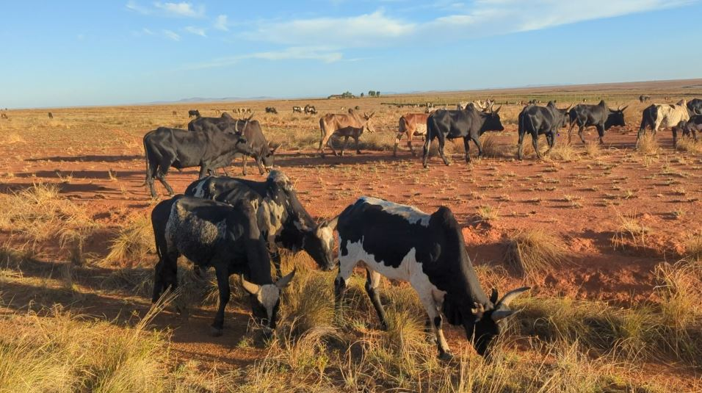
Thank you for your kind attention

