Slide 1


LAND REFORM IN MADAGASCAR:
rationales, achievement and institutional challenges
Perrine Burnod ^{1&2}, Heriniaina Rakotomalala³, Emmanuelle Bouquet⁴
¹Think tany, Madagascar; ² Cirad-UMR TETIS, ³ FAO, ⁴ Cirad-UMR MOISA
World Bank Land Conference, 13 – 16 May, 2024, Washington DC

Slide 2
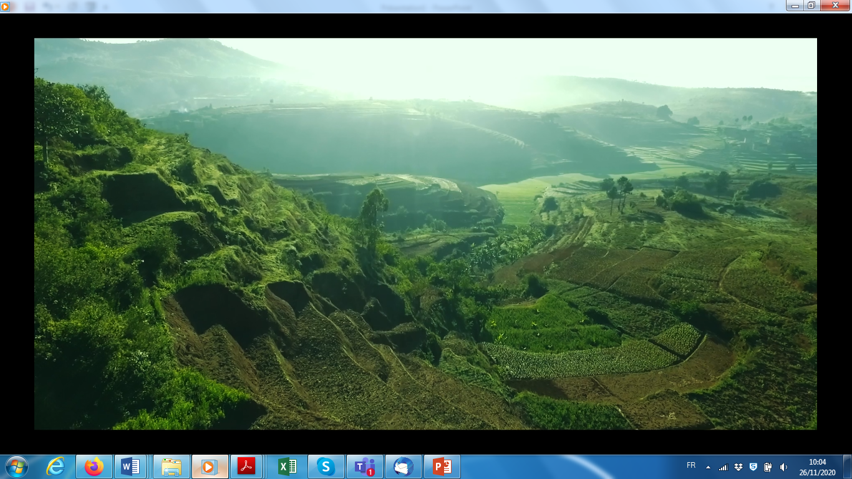
1. Context & Research question

Slide 3
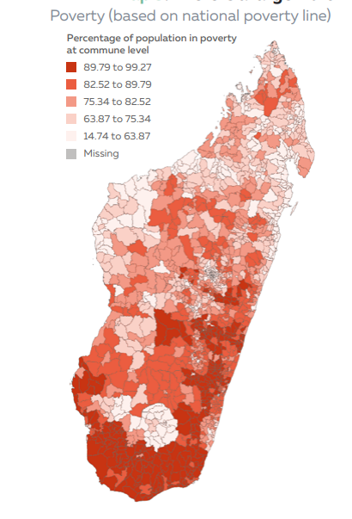
Madagascar
23 regions, 119 districts, 1693 communes
Population : 30 millions
Poverty :
75 % of the population (2,15$/day/person)
Agriculture :
4 out of 5 households earn their living from agriculture
Average farm area : 0,6 hectare
World Bank, 2022

Slide 4
The Malagasy land reform, on going since 2005
Land reform :
  Decentralization of land management: local land offices (LLO) at commune level,
  Land Certification to register private property
3 main objectives (op. cit, Jacoby and Minten, 2006, Bouquet et al., 2016):
  to overcome the pitfalls of the former land titling system that mainly benefit to economic and political elites,
  to provide tenure security to a majority of households thanks to a low cost, easy and participatory registration process,
  to foster economic impacts: notably agricultural investment and access to credit
Contrary to similar land reform (Ethiopia or Rwanda) (e.g. Deininger et al., 2008; Ali et al., 2016), land certification is “on demand” and not based on a systematic demarcation process.

Slide 5
What has been achieved after 20 years of reform?
How land reform is really implemented and appropriated at both national and local level?
Socio/ Equity effects: Does certification is really massive and inclusive or the preserve of the elites?
Economic effects: What are the effects of certification at the household level?
Effects in terms of governance: Have land tenure governance and institutions in Madagascar really changed?

Slide 6
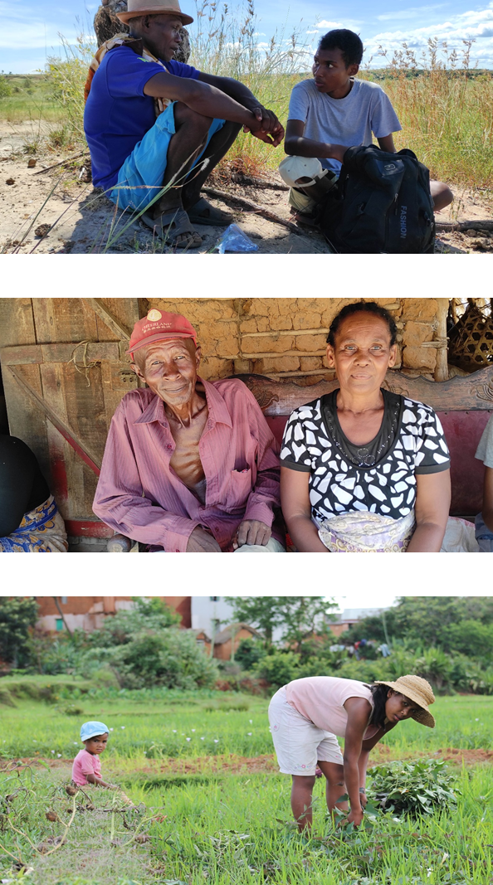
Methodology and data
A comprehensive synthesis
Over 10 years of research by teams of scholars and experts from
  Land Observatory, affiliated with the Ministry responsible for land affairs (2014-2019),
  Think Tany, a think tank affiliated with the University of Antananarivo) (2019-now)
Data production was based on a mixed-method approach:
  Qualitative interviews & field visits
  specially designed surveys on large samples of rural households :
    in 2011 and 2015 (PECF Survey, 1,834 households with 1,551 in the panel),
    in 2019 (Salima Survey, 450 households),
    and in 2021 and 2022 (Women Land Access Survey, 423 households).

Slide 7
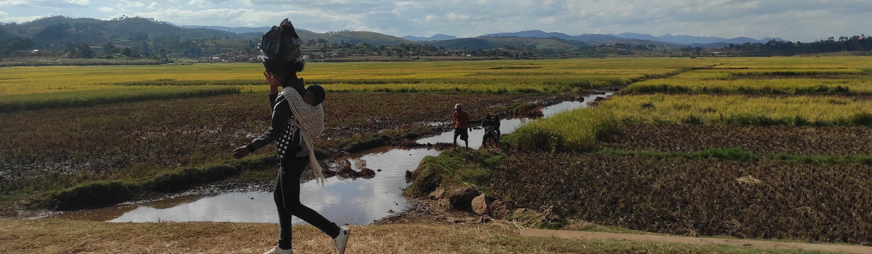
2. The rationales of the 2005 land reform

Slide 8
Prior to 2005
All land :
belonged to the State, except the land titled in the name of private individuals
was managed by central and deconcentrated Land administration (district and regional capitals)
The only way to secure land tenure was to obtain a title but :
only 600,000 titles issued in 110 years covering 10% of the territory.
procedure was complex and costly : in average 6 years and $500
A considerable gap between the legal system and local land tenure systems
From a legal point of view, most of the rural households were not recognized as landowners because they did not hold formal land titles
Land Titles were inadequate to meet the needs of millions of citizens : poverty & priority to the legitimacy of rights based on custom and local rules

Slide 9
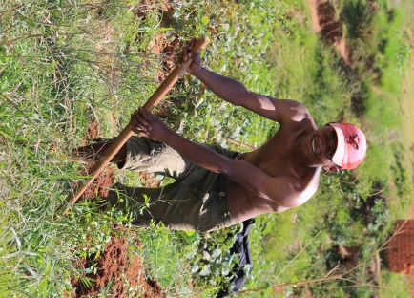
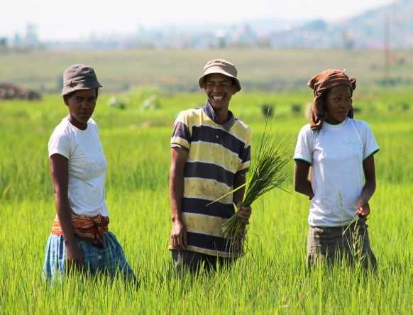
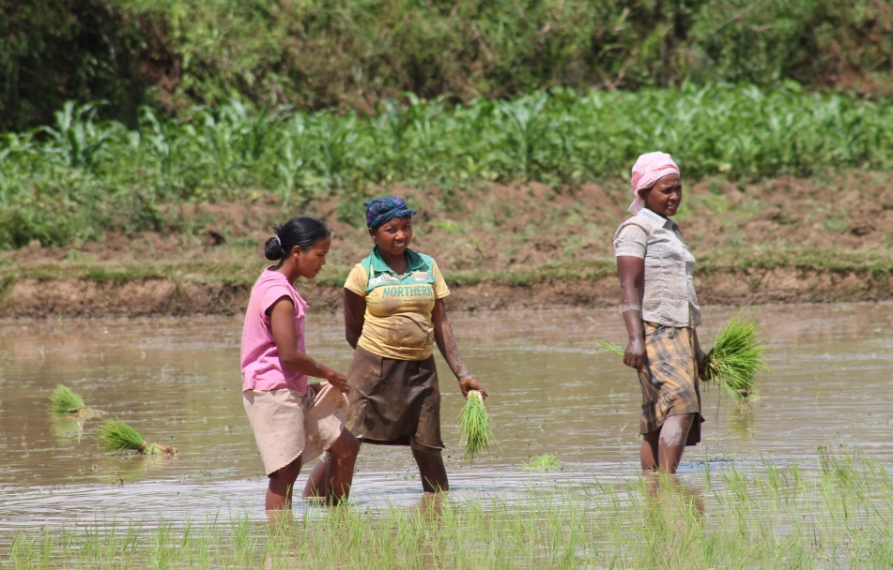
1rst innovation : A new legal category
In 2005, a land reform based on 3 major innovations
Allows the legal recognition of local rights to agricultural land
Labelled untitled private land
Based on the principle of presumed private ownership (which replaces the principle of presumed State ownership)
Gives a first level of legal protection even without any formal documents

Slide 10
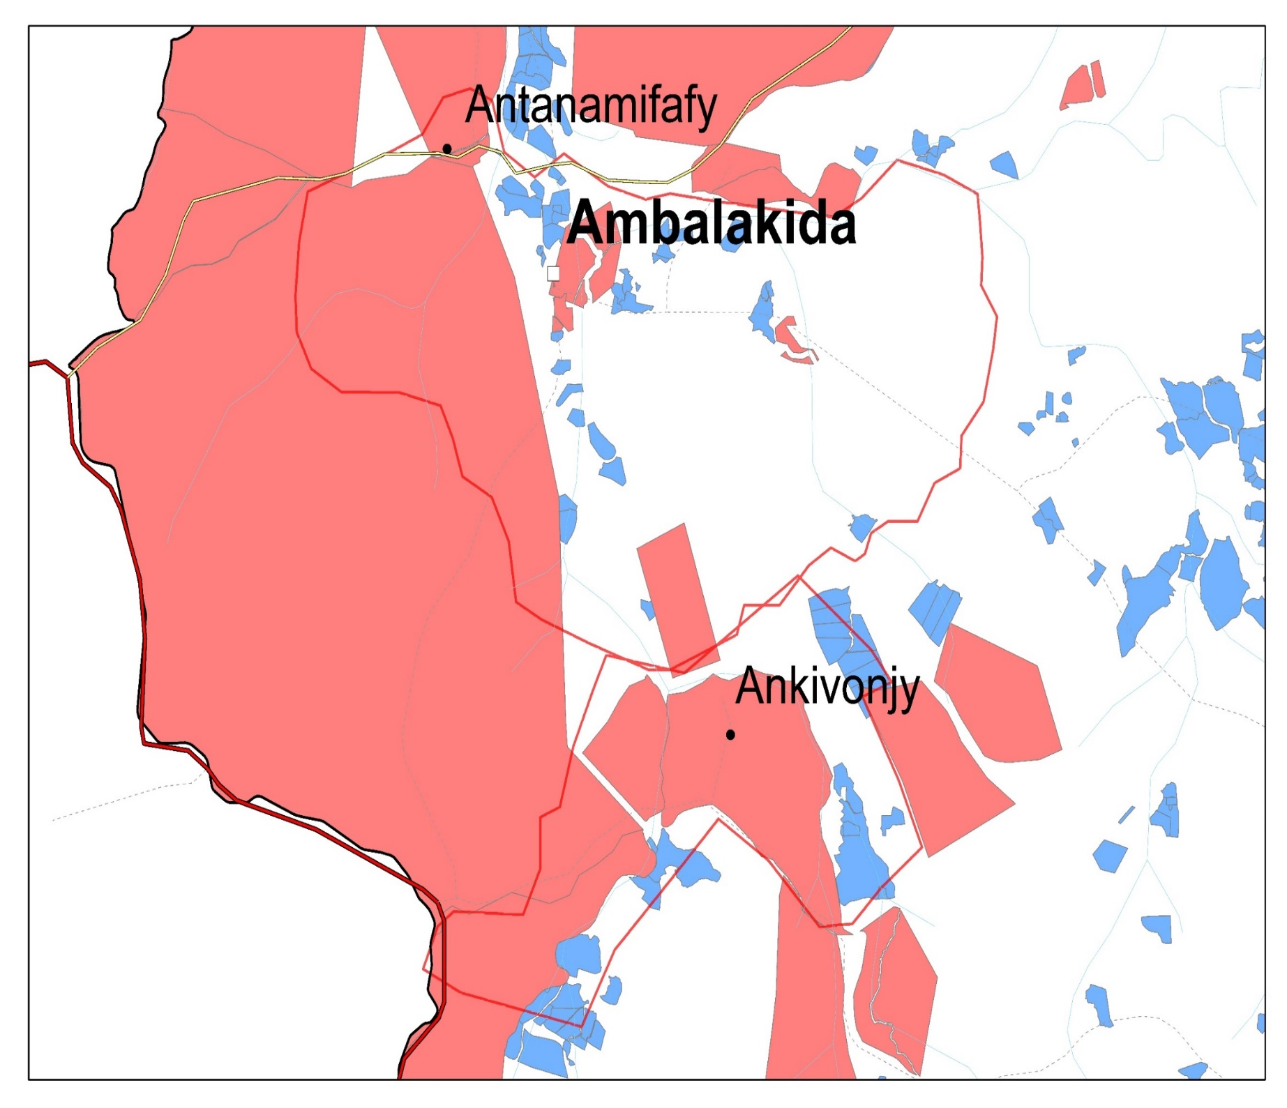
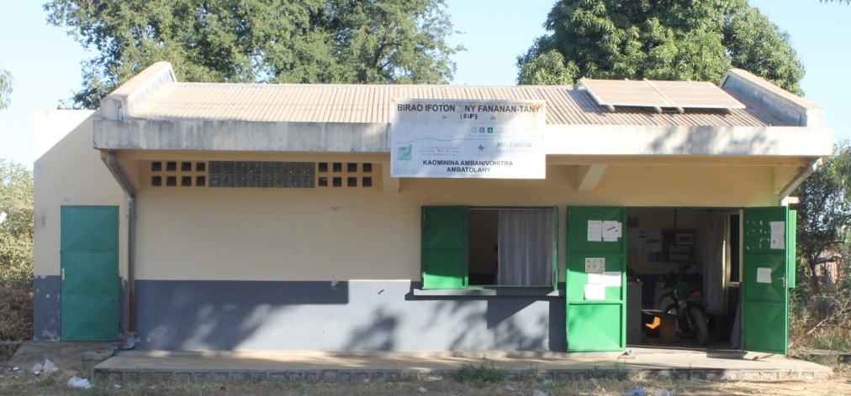
2nd innovation : communal land offices
the communes acquire new powers. Once they have set up a communal land office (CLO), they can certified plots (on the plan LLUP and in land register) and issue land certificates.
Local land occupation plan (LLUP) on high resolution satellite images
Titled land in red, Certified land in blue
Communal land office (CLO)
Notes:
The LLUP is a cartographic tool that displays the spatial distribution of various land statuses overlaid on high-resolution satellite or aerial images. By identifying titled land and land in the process of being registered, it delineates areas eligible for certification (as certificates can only be issued for land outside titled areas) and progressively certifiable land.

Slide 11
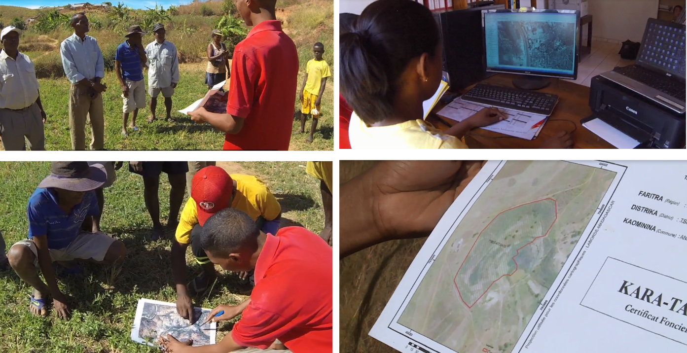
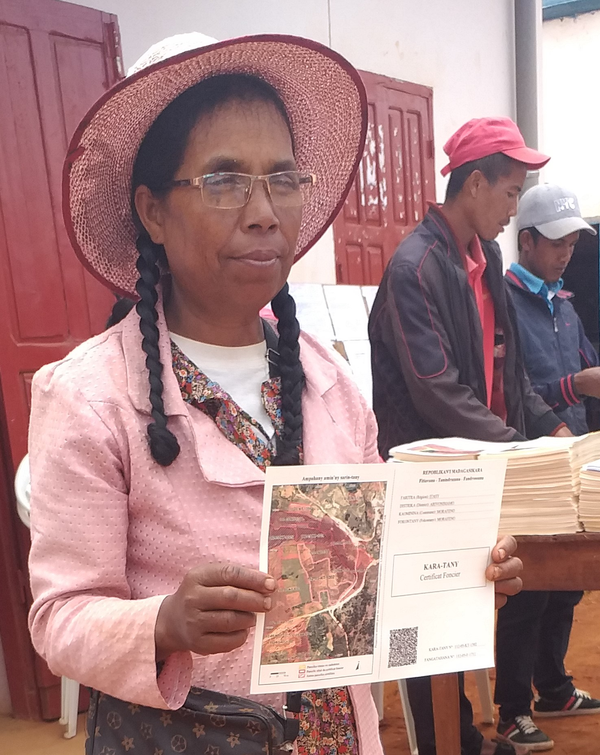
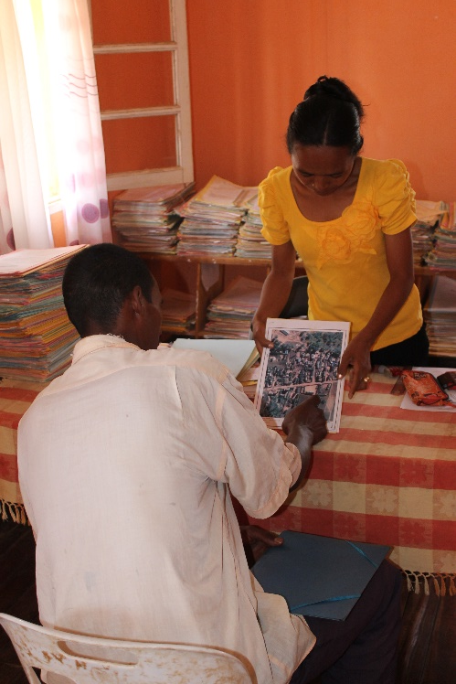
3rd innovation : land certificate
Legal proof of ownership such as title:
On-demand, fee-based procedure
To register private property
Transferable and mortgageable
A different process from title :
Register only existing land rights (do not create new rights)
Local skills and simple tools: legitimacy, not technicality
No need for formal proof, right validation commission, consensus
Price (10 to 15 US$, 30 times cheaper/title) and duration of procedure (6 to 12 months, 10 times faster/title)

Slide 12
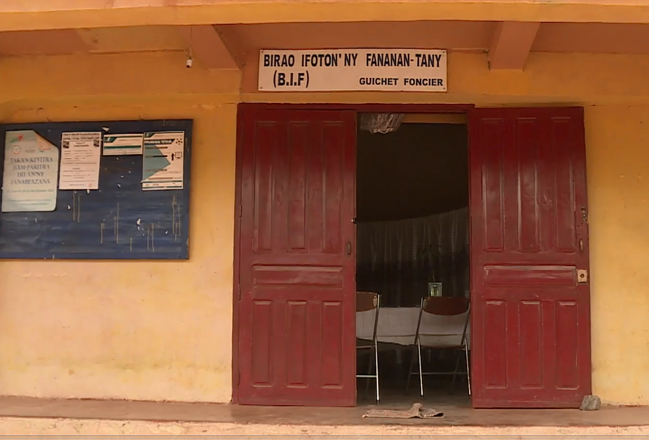
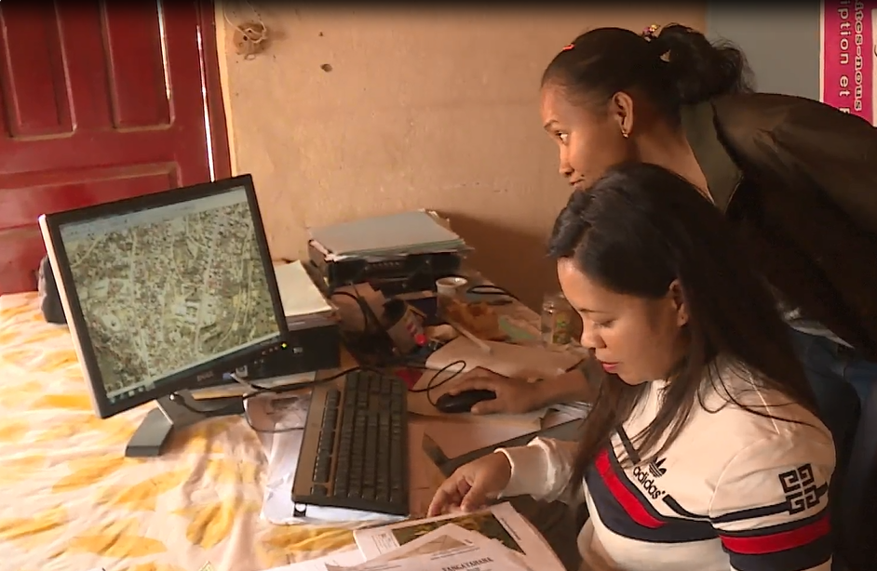
3. Implementation at national level

Slide 13
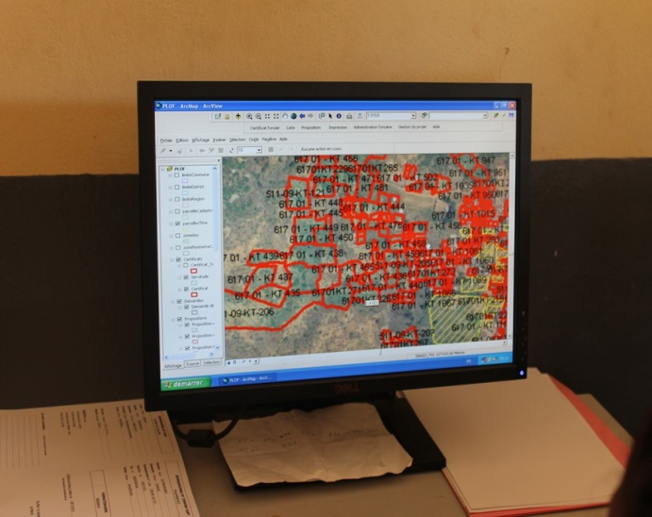
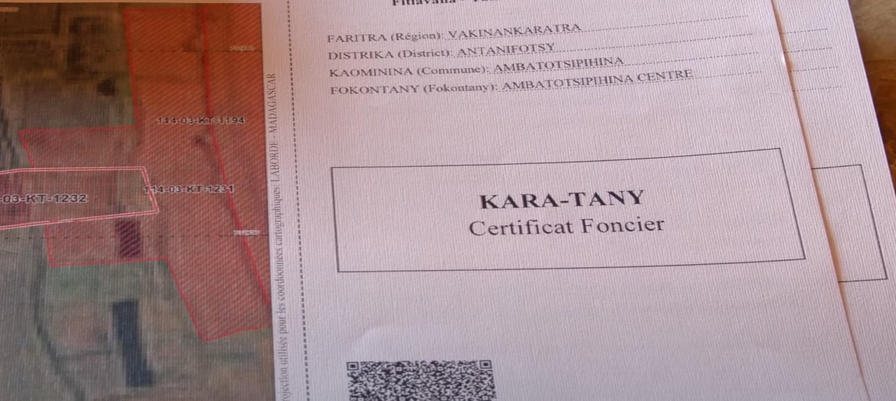
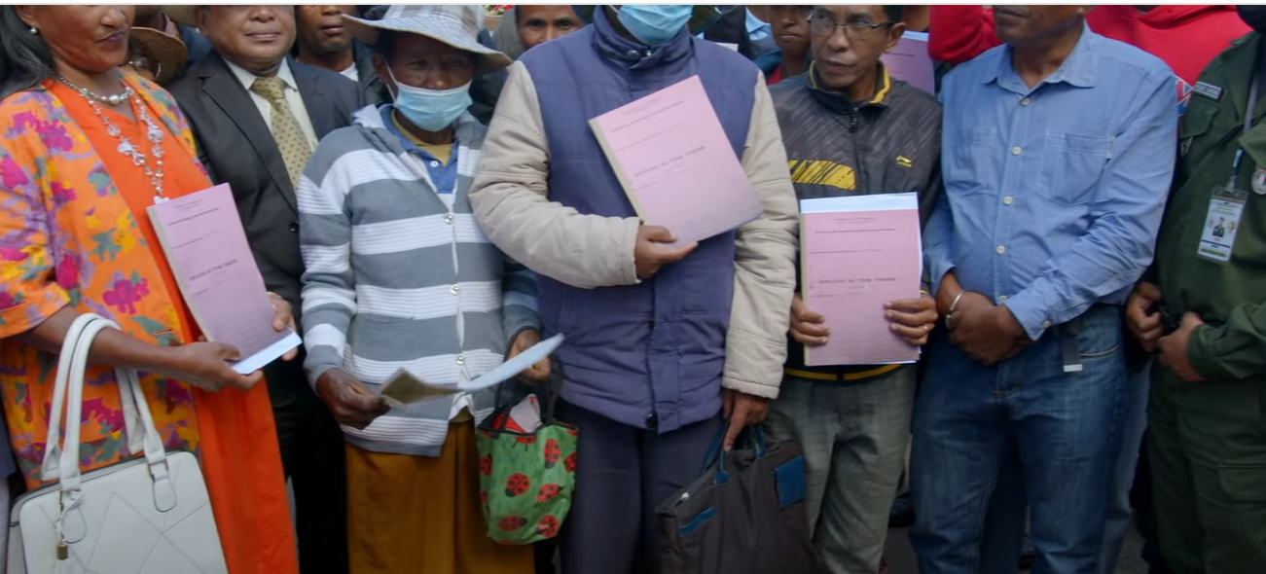
The pilot stage of the land reform was well and truly over.
Financed by more than 20 different development projects (varying size) over the 20-year period
546 local land offices
=> 1/3 of the communes.
Certificates supplant titles.
Nearly 1,300,000 certificates issued

Slide 14
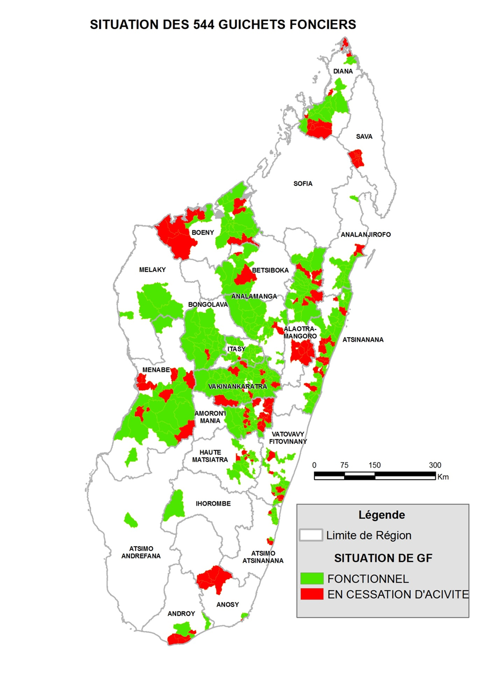
A deployment of CLO has been uneven over time:
in line with donor funding and political crises
A deployment of CLO has been uneven across the region. CLO located in the most densely populated and accessible areas.
reflects both decision-makers' choices and projects' choices => for reaching the maximum number of people/voters in the shortest possible time,
reinforces territorial inequalities in terms of access to public services.
Location of communal land offices in operation (70%) and ceasing operations (30%) in 2019

Slide 15
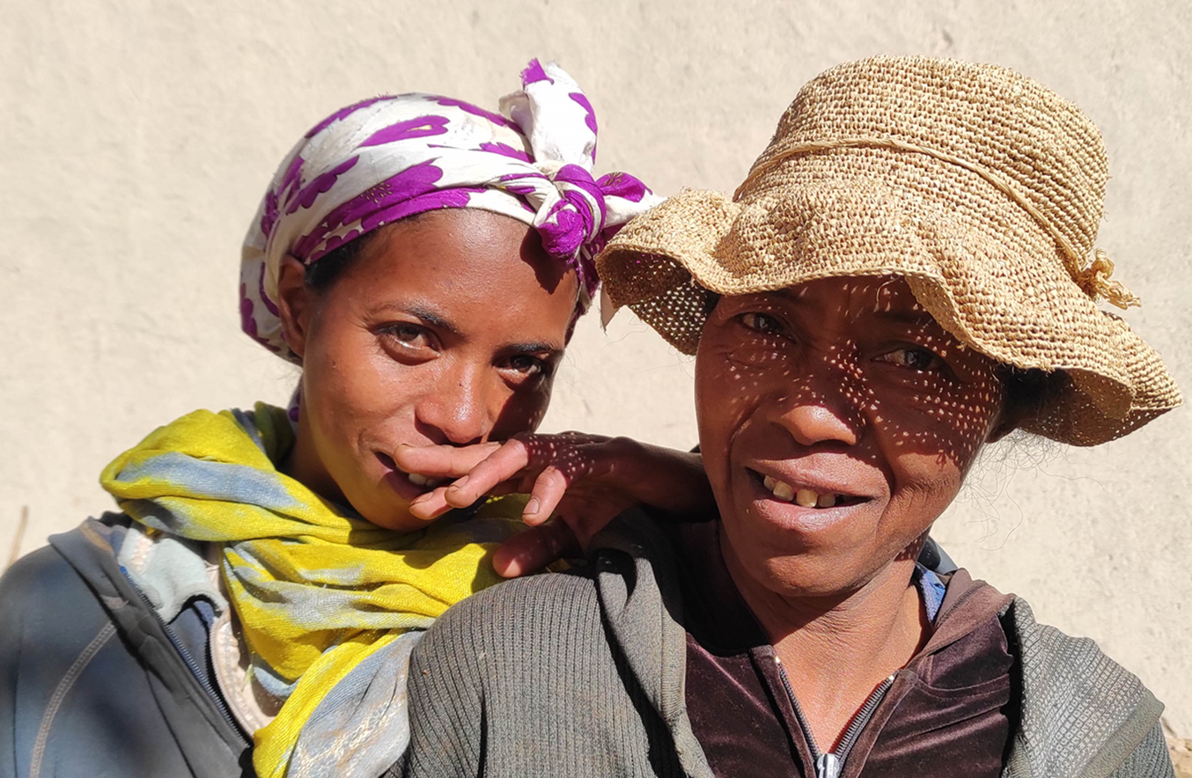
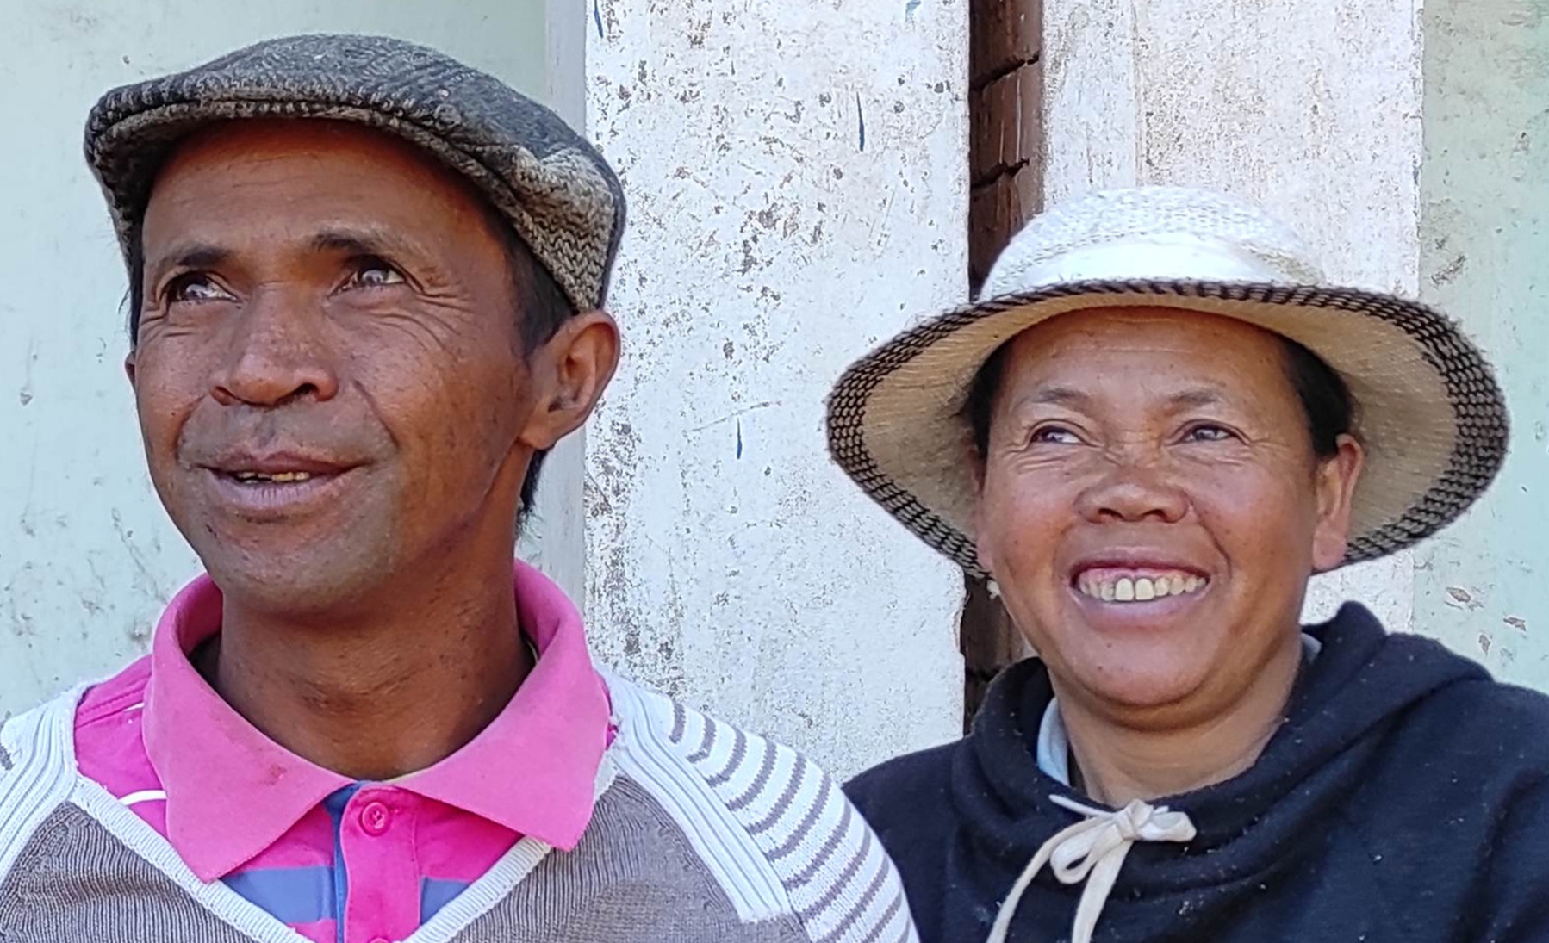
4. The effects of CERTIFICATION at household level

Slide 16
Certification is not yet massive, but more inclusive than title registration
Since 2005, nearly 1,300,000 certificates have been issued.
On a country-wide scale, certification does not reach the majority of citizens, but it already affects a far greater number of rural households (13% out of an estimated 4 millions) than title registration (2%).

Slide 17
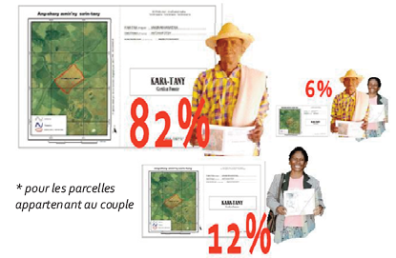
Equity effects : an inclusive certification process, but a scope that needs to be consolidated
Certification benefits all household profiles.
The statistics available do show some positive trends in access to certification over time : poorest, least-educated households, migrants and women
But in the case of joint ownership, some certificates registered in the name of only one person.
=> Plots belonging to a couple are often registered solely in the husband’s name (sample of 423 certified plots - PECF)

Slide 18
Economic effects : Effects differing from those expected
Certification has had little impact on:
  investment (multi-constraints),
  access to credit (very limited offer in rural areas)
  or increased market transfers (already active land markets secured by local and semi formal documents).
2 outcomes of the reform that was not mentioned in the initial objectives have been:
  the provision of free information and advice on land tenure.
  the consolidation of the role of local land management institutions
  => 2 key dimensions of land tenure security

Slide 19
5. Difficulties encountered in decentralizing land management

Slide 20
Effects on governance and ownership of land tenure security systems (CLO & certificates)
A policy is reflected not only through actions but also inactions or various types of blockages driven by actors with divergent interests
The decentralization of land management
  Has led to a redistribution of power
  Has sparked tensions within the State apparatus and among the stakeholders involved in land governance

Slide 21
Effects on governance and ownership of land tenure security systems (CLO & certificates)
Regularly weakened and limited by the land administration (changes in legislation, delayed delivery of plans, increasingly complex procedures): slowdown in deployment and pending rules
Strongly supported by donors (unblocking through project financing and support for civil society)
Supported by representatives of civil society and development operators, and depending on the period by elected representatives, but with irregular impacts
Importance of means of action in policy definition
Appropriated by Communes, who are struggling to finance CLO and are increasing the cost of certificates.
Not contested by local and traditional authorities, whose role is maintained (participation in the certif. process)
Reformative trends
Conservative trends

Slide 22
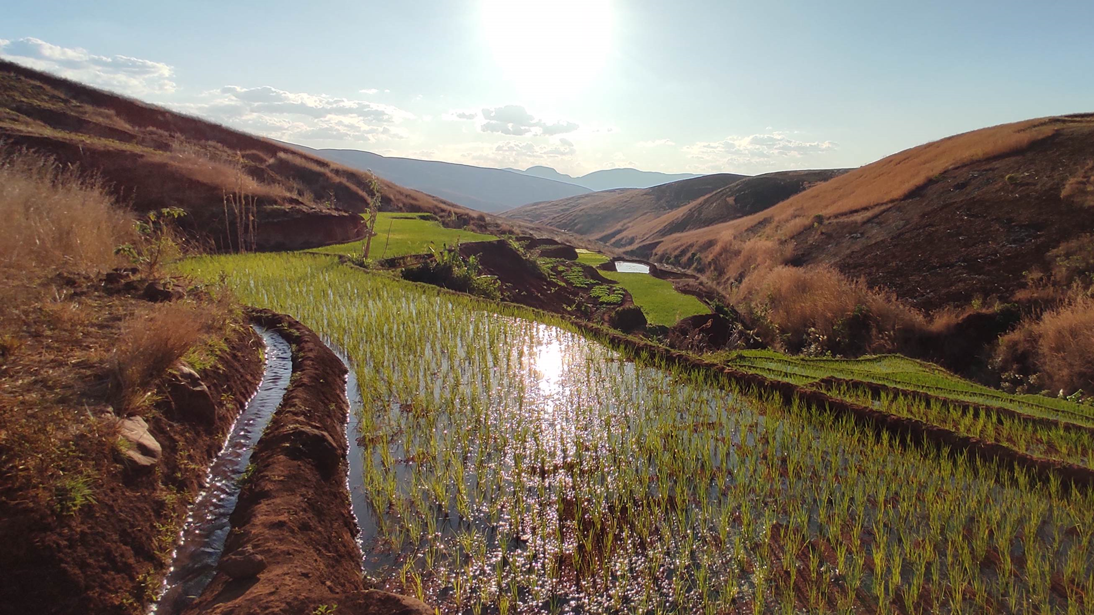
6. Policy implications: challenges and prospects

Slide 23
Improving certification processes
the inclusiveness of certification needs to be extended :
  through the continuation of reduced fees and systematic plots census (subsidized operations driven by development project)
  by maintaining a technically simple, low-cost procedure.
  by providing better information regarding the possibility of registering all entitled parties on the certificate: both spouses, siblings, or larger collectives.
the sustainability of certification must involve real-time updating of certificates in line with transfers (sales, inheritance) on land registers and LLUP,
pending wider deployment of CLO and certificates, - Acknowledgment and improvement of the role played by semi formal document established at local level (minimum information to be entered, witness signatures to be affixed, village chief’s field checks, etc.)

Slide 24
Sustaining and strengthening the decentralization of land management
deployment of CLO in each commune, but also technical and financial reinforcement of all CLO, notably through state subsidies and training,
expansion of communal land office intervention zones: pastures or forest area => on community-managed land.

Slide 25
Social and political ownership of reform
Issues of governance and power can be more decisive than technical issues. Land reform is necessarily a long-term process with significant power struggles :
Encourage debate based on knowledge of local practices and issues
Increase the level of information and skills of all actors involved in these debates,
Involve representatives of the various user groups and rights holders, as well as intermediary bodies (civil society, trade unions, elected representatives, government technical services, etc.).

